Slide 1
Group 6
Nature or Nurture?
Estimating Obesity Based on Physical Condition & Eating Habits
STAT3622 Final Project Presentation by
Group 6
Soo-ah Kim (3035661061) &
Dongjun Yeom (3035666463)

Slide 2
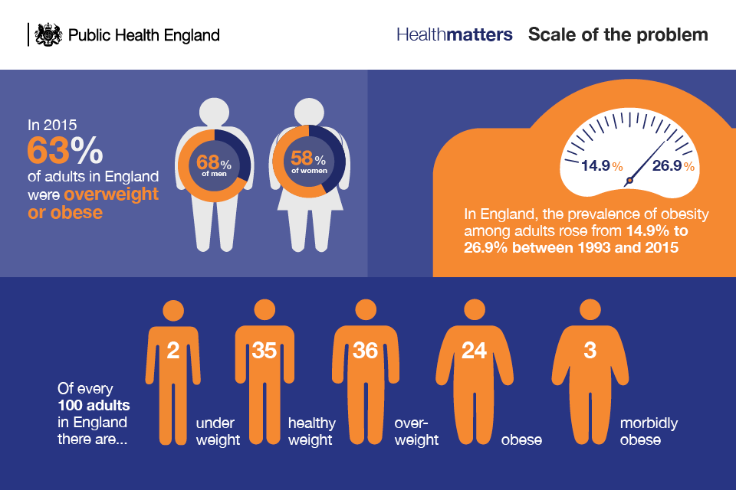

Slide 3
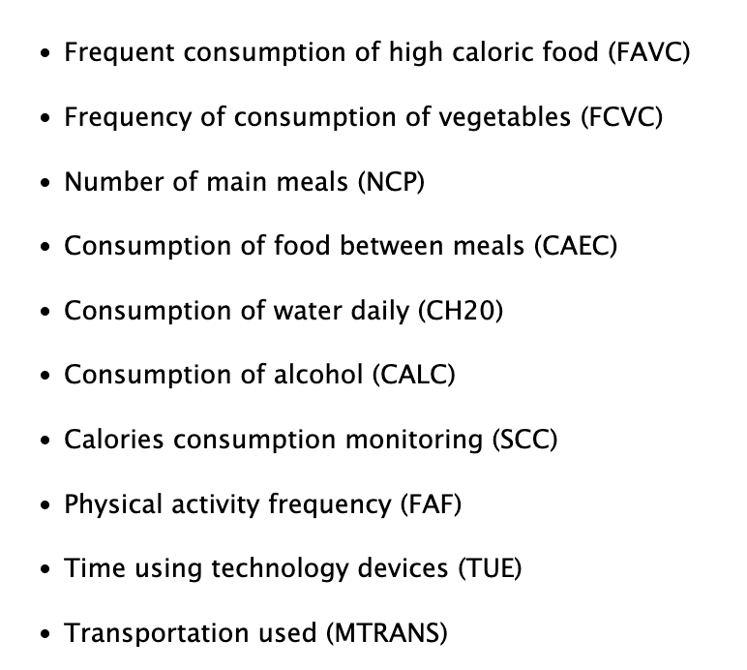
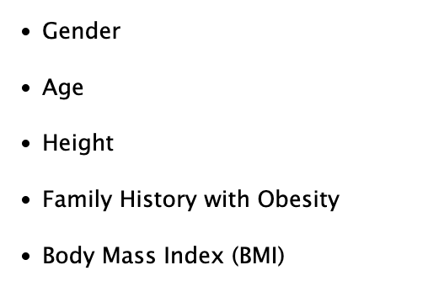
Group 6
Estimation of Obesity Levels Based On Eating Habits and Physical Condition
Physical Condition
Habits

Slide 4
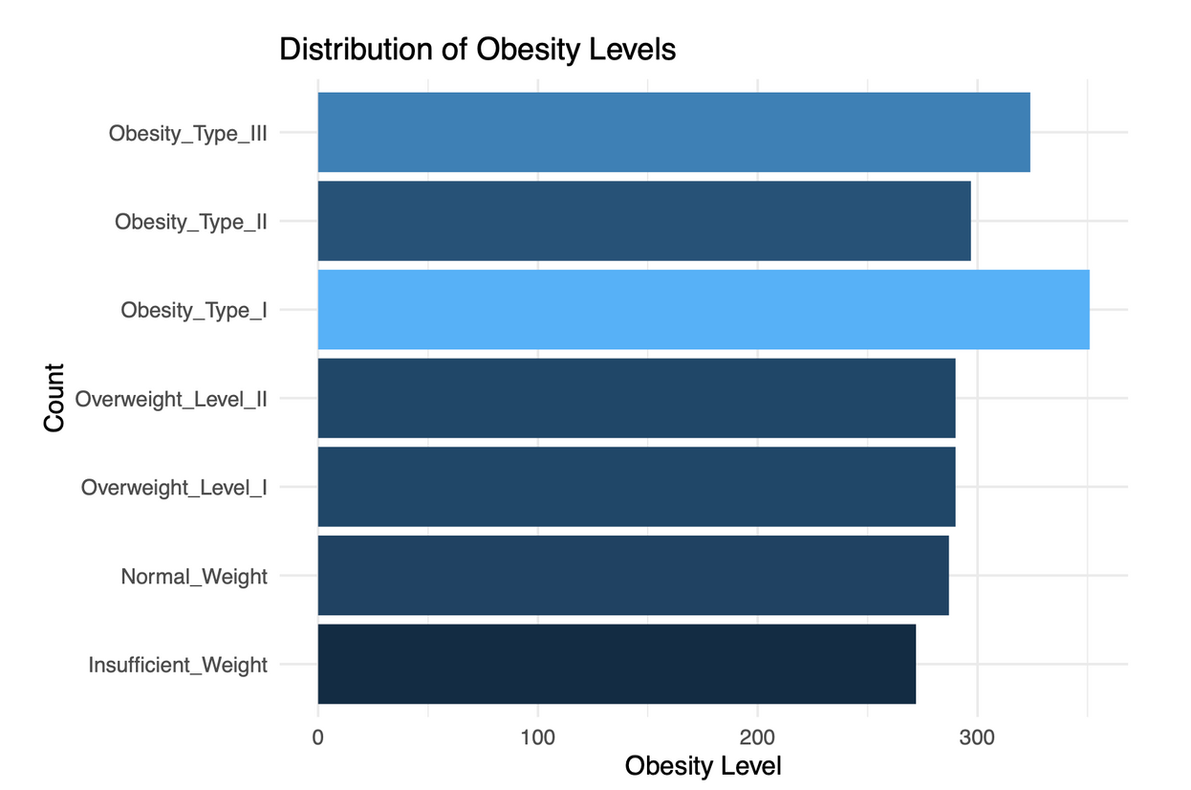
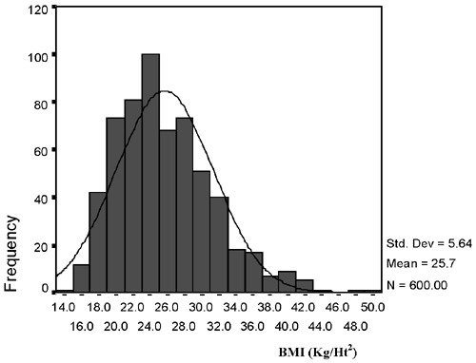
Group 6
Distribution of Obesity Levels
Distribution of Obesity Levels
Al-Malki et al., 2003
No class imbalance
Might indicate a sampling bias due to difference with the real world distribution

Slide 5
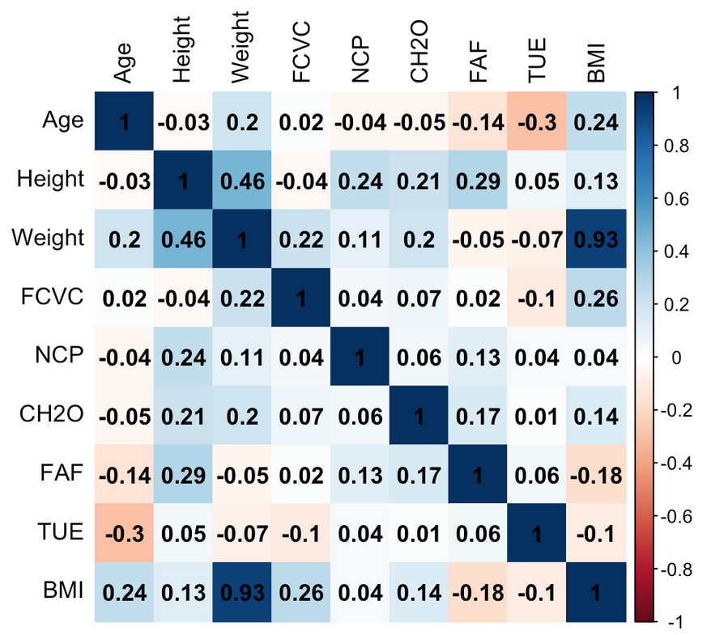
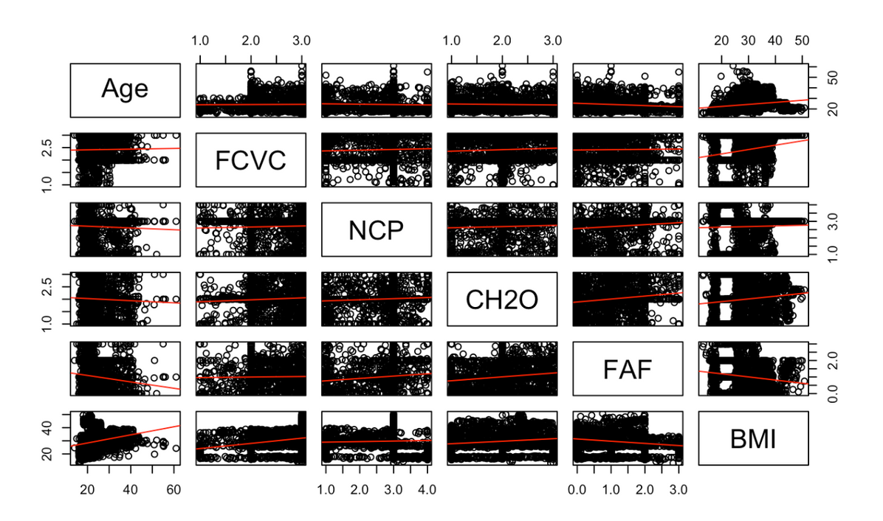
Group 6
Correlation between variables
Correlation Plot
Pairewise Plot

Slide 6
Group 6
Correlation between variables
Correlation Plot
Pairewise Plot
due to multicolinearity

Slide 7
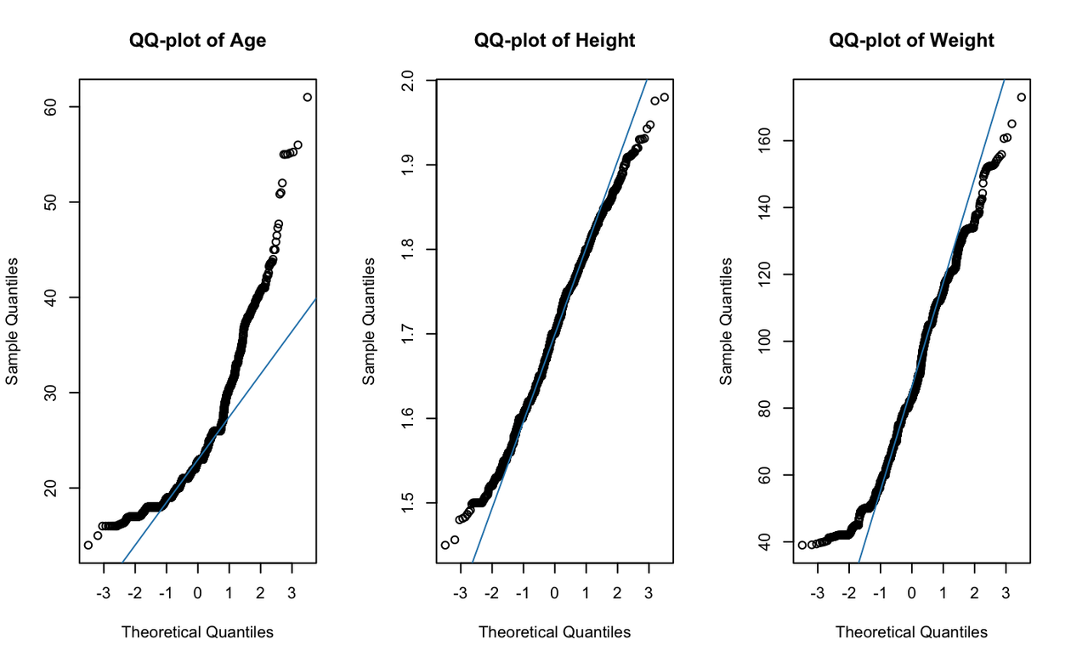
Group 6
Distribution of numeric variables
QQ-Plots
Height and Weight roughly follow the normal distribution
Age does not
Shapiro-Wilk Normality Test
W = 0.86606
p-value < 2.2e-16
suggests a noticeable deviation from the normal distribution
Kurtosis
5.816858
distribution has heavier tails than a normal distribution (=3)
Solution: avoid models that assume normality or normalize using log or sqrt transformations

Slide 8
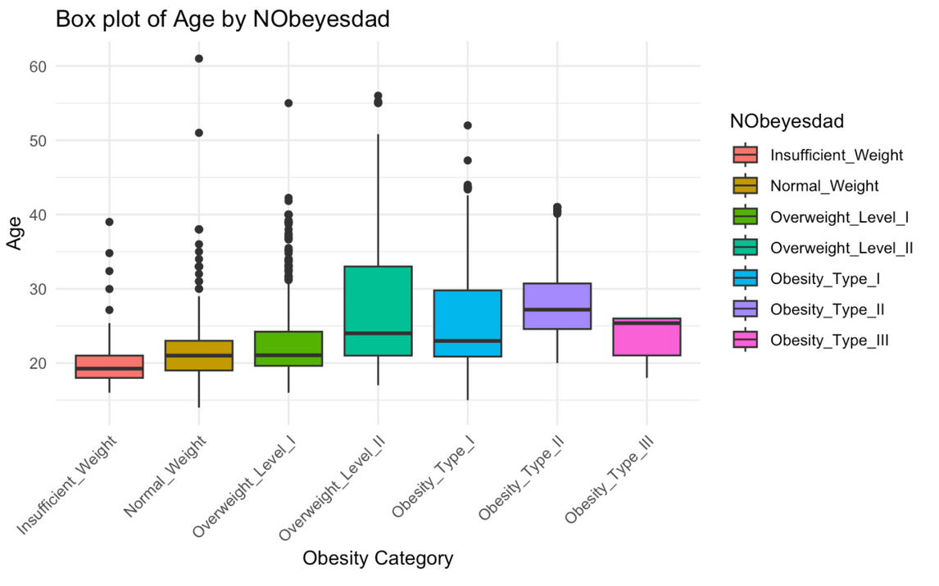
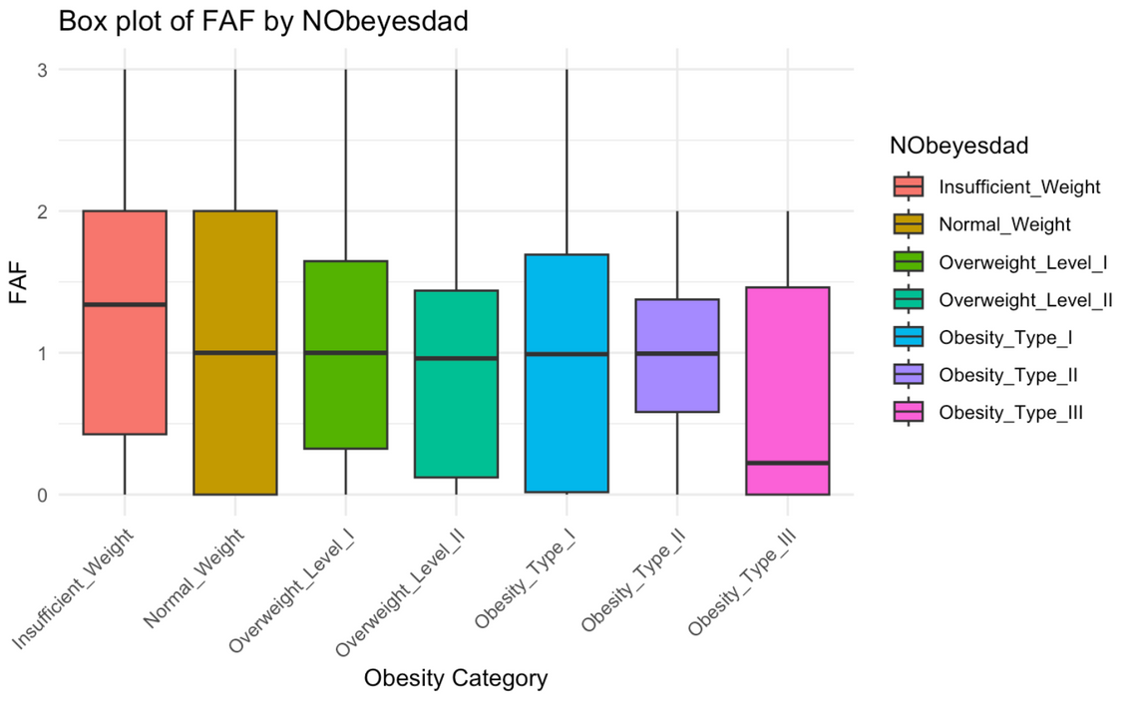
Group 6
Box Plots by Obesity level
Age
FAF (Frequency of Physical Activity)

Slide 9
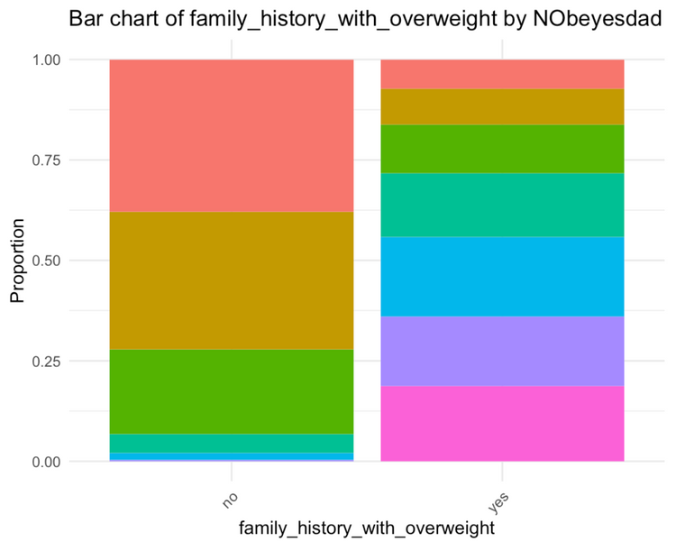
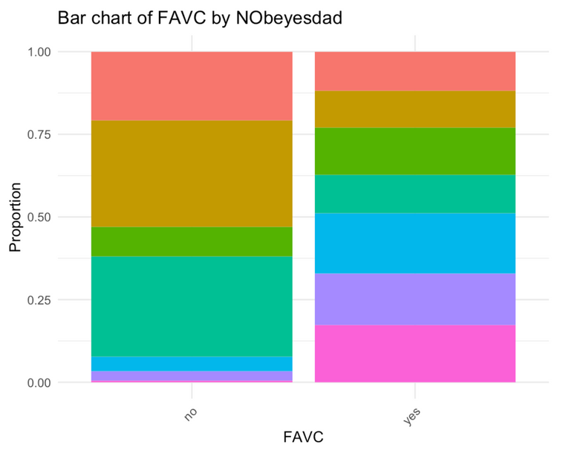
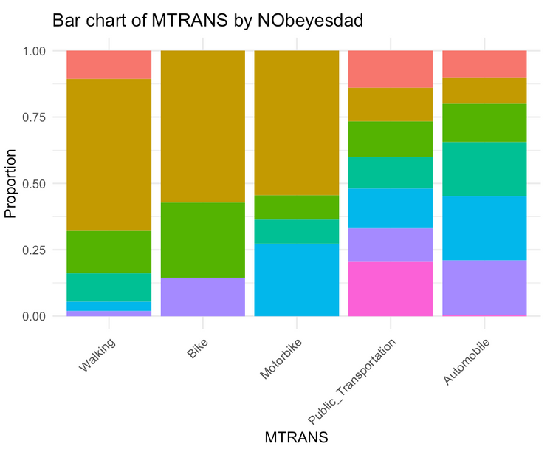
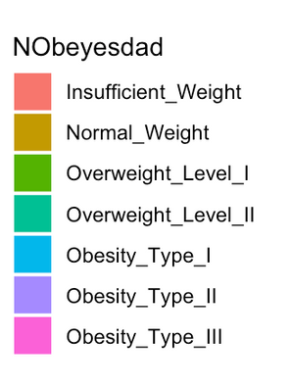
Group 6
Bar Charts by Obesity level
Frequent comsumption of high Caloric food
Family history of obesity
Mode of transportation
Interesting bar charts
People with obesity tend to have family history of obesity
People with obesity tend to frequently consume high caloric food
Mode of transportation is also highly related to obesity!

Slide 10
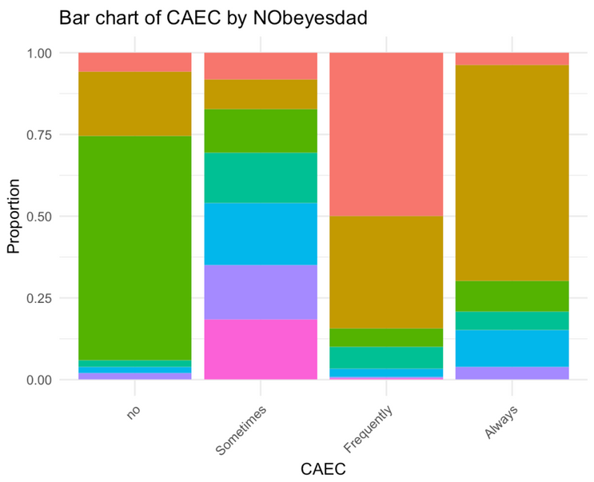

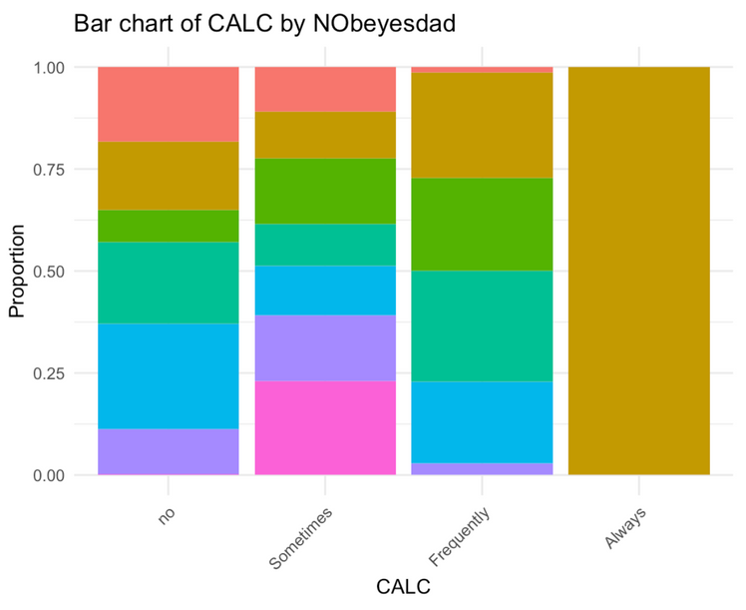
Group 6
Bar Charts by Obesity level
Consumption of food between meals
Frequent comsumption of vegetables
Consumption of Alcohol
Interesting bar charts (counterintuitive?)
Overweight or obese people tend to not or only sometimes consume food between meals while underweight or normal weight people tend to frequently or always eat between meals
People with obesity tend to more frequently consume vegetables
Overweight or obese people tend to not or only sometimes consume alcohol

Slide 11
Group 6
Summary of EDA
Removed columns due to multicolinearity
BMI: too highly related to weight & height
Are the numeric variables normally distributed?
Age is not normally distributed
avoid models that assume normality

Slide 12
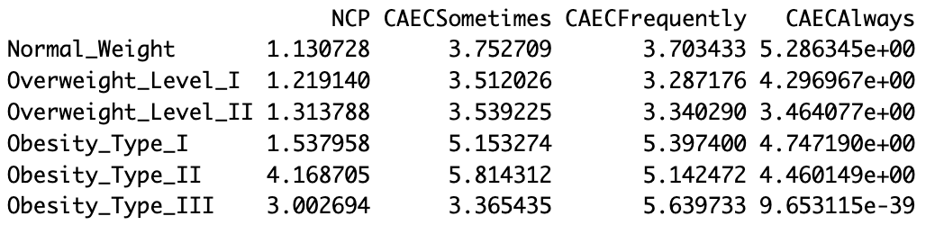

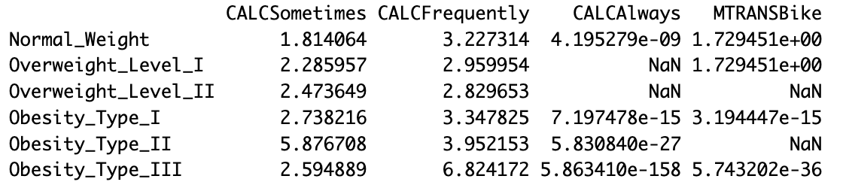
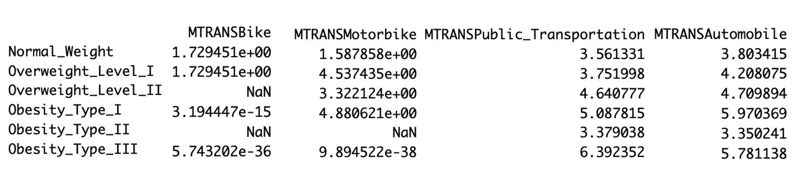
Group 6
Multinomial Logistic Regression
Consumption of Food between Meals
Degrees of freedom
= (Number of Observations) − (Number of Parameters)
= 2111 - 24 = 2087
Consumption of Alcohol
Mode of Transportation

Slide 13
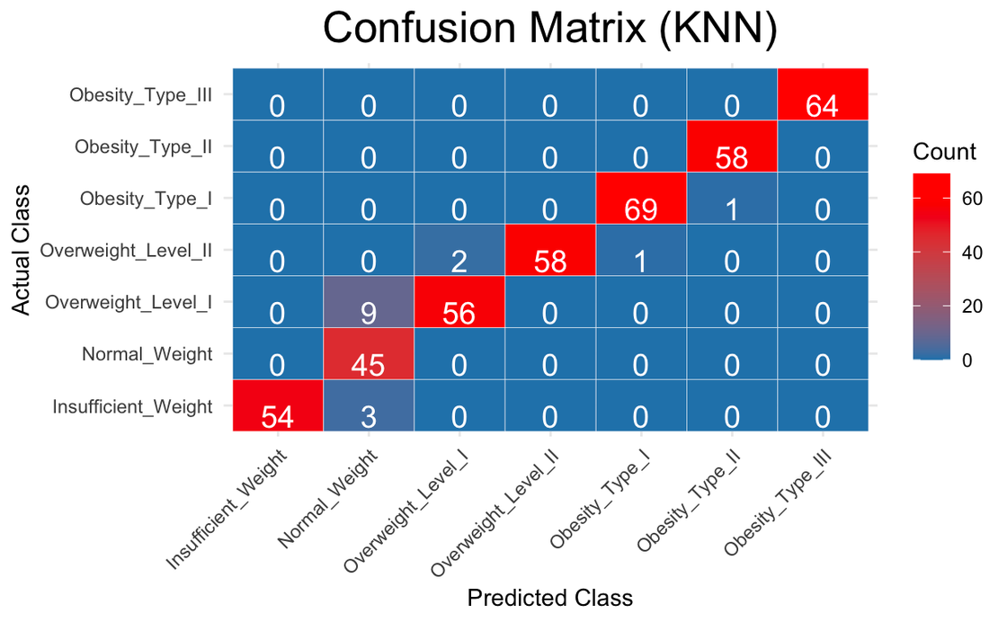
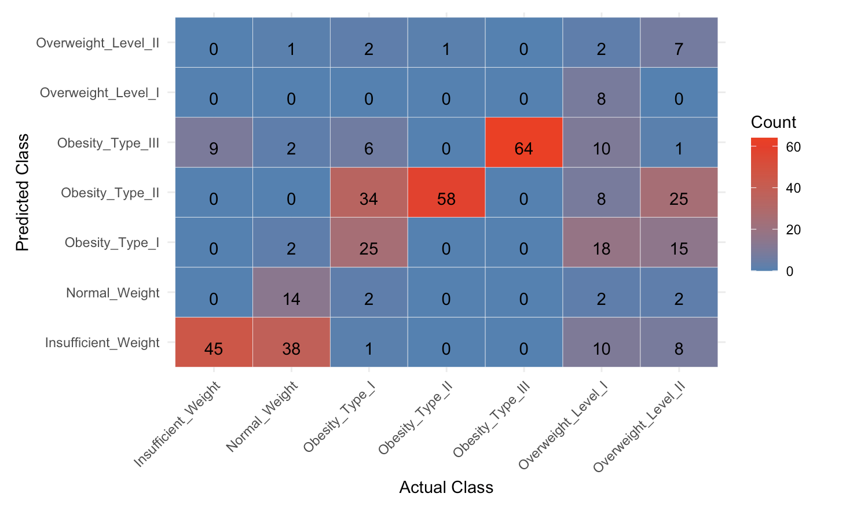
Group 6
K-Nearest Neighbors Analysis
Key Takeaways:
Model partition
Train = 80%
Test = 20%
Similarity-based prediction
Accuracy = 0.8190476
Model Performance:
Scores | Micro.Average
Precision | 0.962963
Recall | 0.8387097
F1 Score | 0.8965517

Slide 14
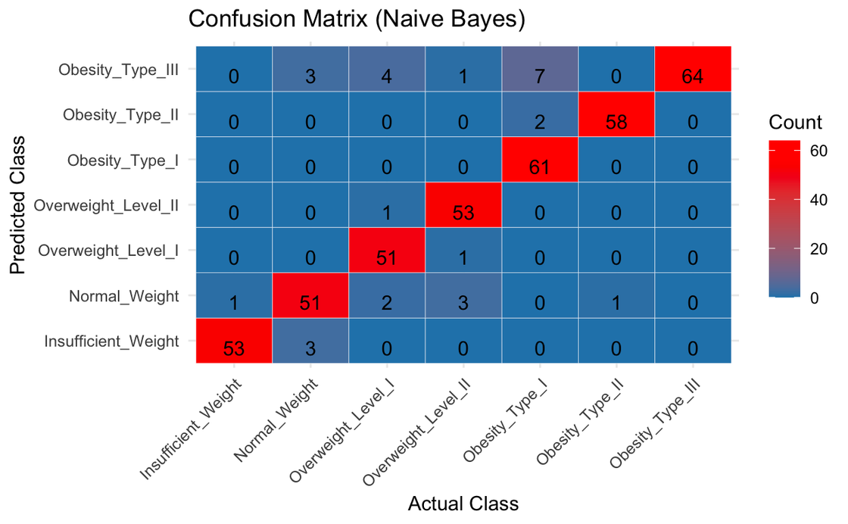
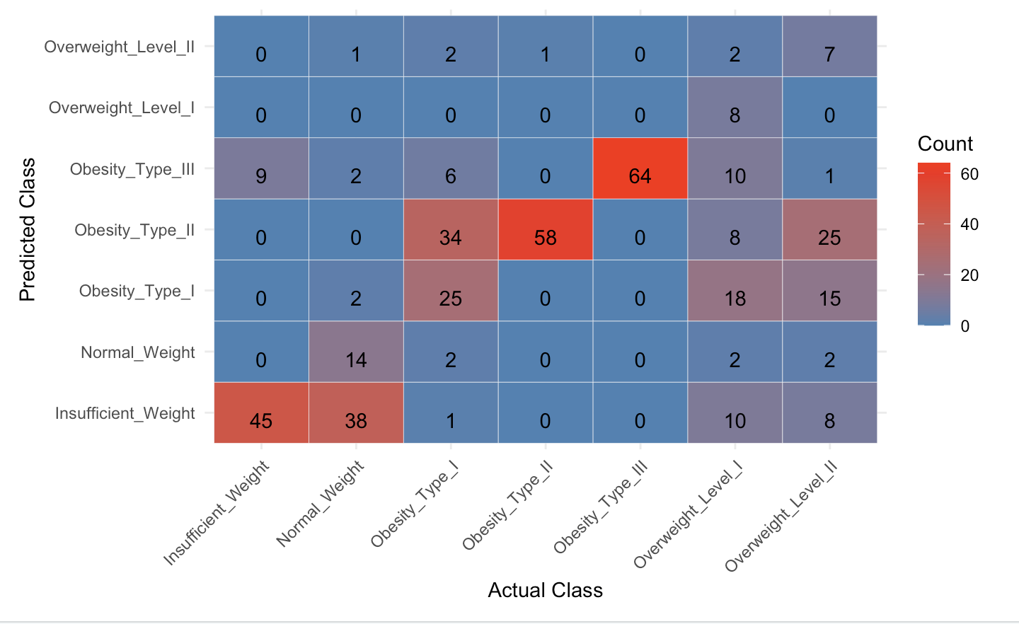
Group 6
Naive Bayes Analysis
Key Takeaways:
Probabilistic Approach
Accuracy = 0.5261905
Model Performance:
Scores | Tier 1 | Tier 2 | Tier 3 | Tier 4 | Tier 5 | Tier 6 | Tier 7
Precision | 0.44 | 0.7 | 0.42 | 0. 46 | 0.7 | 1 | 0.53
Recall | 0.83 | 0.25 | 0.35 | 0.98 | 1 | 0.14 | 0.12
F1 Score | 0.58 | 0.36 | 0.38 | 0.63 | 0.82 | 0.24 | 0.20

Slide 15
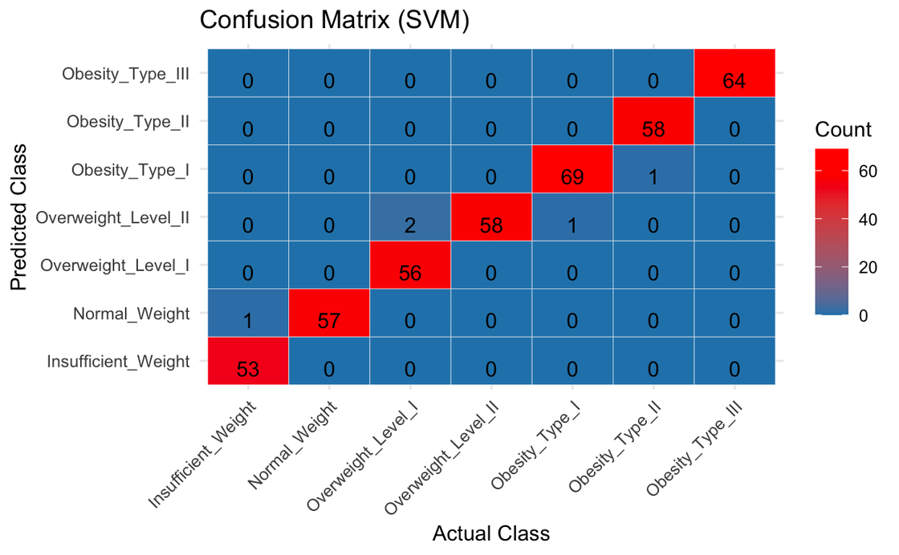
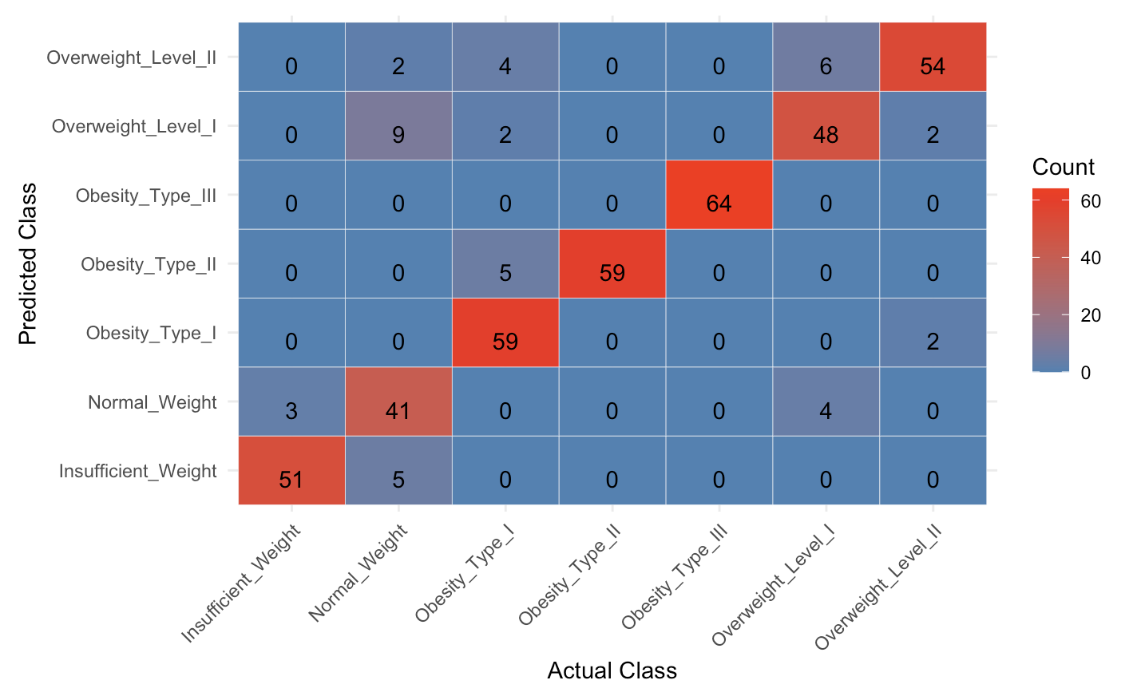
Group 6
SVM Analysis
Key Takeaways:
Complex decision boundaries
Accuracy = 0.8952381
Model Performance:
Scores | Tier 1 | Tier 2 | Tier 3 | Tier 4 | Tier 5 | Tier 6 | Tier 7
Precision | 0.91 | 0.85 | 0.96 | 0.92 | 1 | 0.79 | 0.81
Recall | 0.94 | 0.72 | 0.84 | 1 | 1 | 0.83 | 0.93
F1 Score | 0.93 | 0.78 | 0.90 | 0.96 | 1 | 0.81 | 0.87

Slide 16
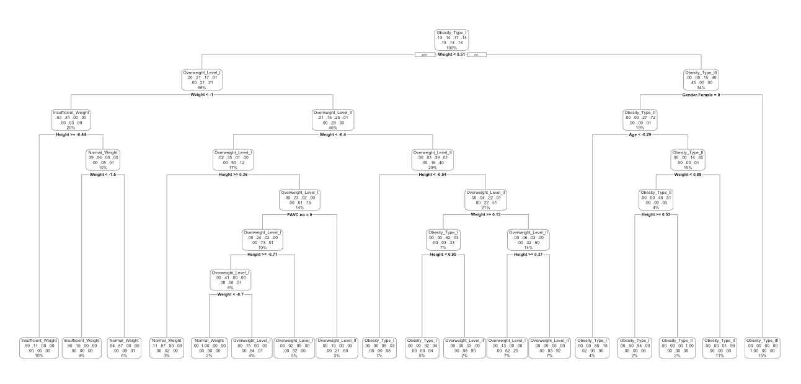
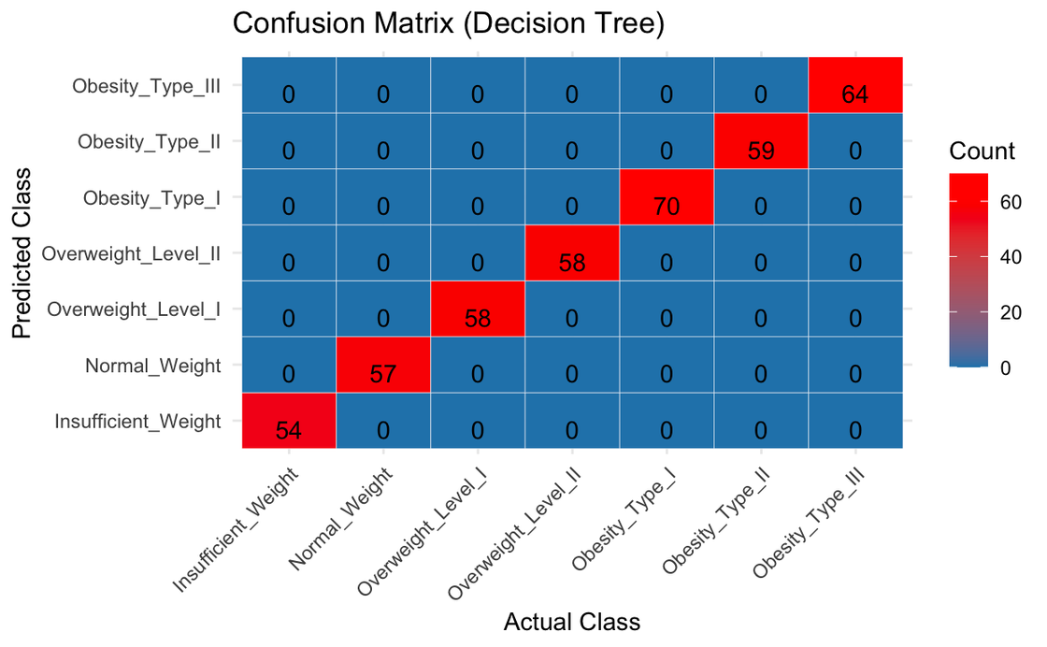
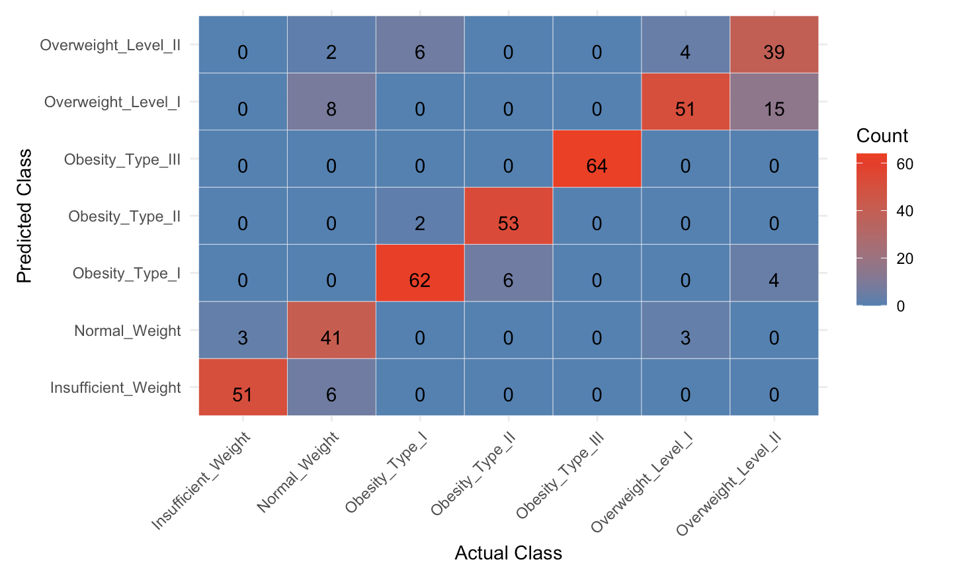
Group 6
Decision Tree Analysis
Key Takeaways:
Easy Interpretation
Accuracy = 0.8595238
Possibility of Overfitting
Model Performance:
Scores | Tier 1 | Tier 2 | Tier 3 | Tier 4 | Tier 5 | Tier 6 | Tier 7
Precision | 0.89 | 0.87 | 0.86 | 0.96 | 1 | 0.69 | 0.76
Recall | 0.94 | 0.72 | 0.89 | 0.90 | 1 | 0.88 | 0.67
F1 Score | 0.92 | 0.79 | 0.87 | 0.93 | 1 | 0.77 | 0.72

Slide 17

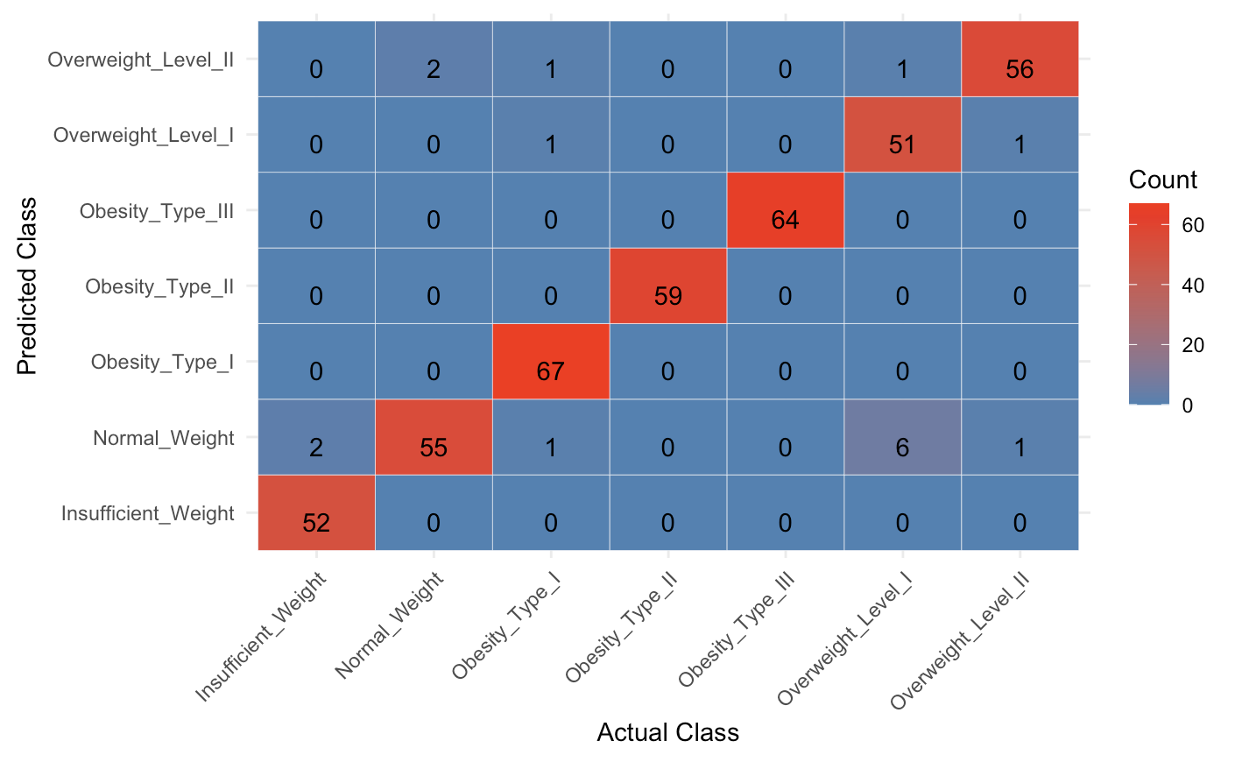
Group 6
Random Forest
Key Takeaways:
Handling complexity and overfitting
Accuracy = 0.9619048
Model Performance:
Scores | Tier 1 | Tier 2 | Tier 3 | Tier 4 | Tier 5 | Tier 6 | Tier 7
Precision | 1 | 0.85 | 1 | 1 | 1 | 0.96 | 0.93
Recall | 0.96 | 0.96 | 0.95 | 1 | 1 | 0.88 | 0.97
F1 Score | 0.98 | 0.90 | 0.98 | 1 | 1 | 0.92 | 0.95

Slide 18
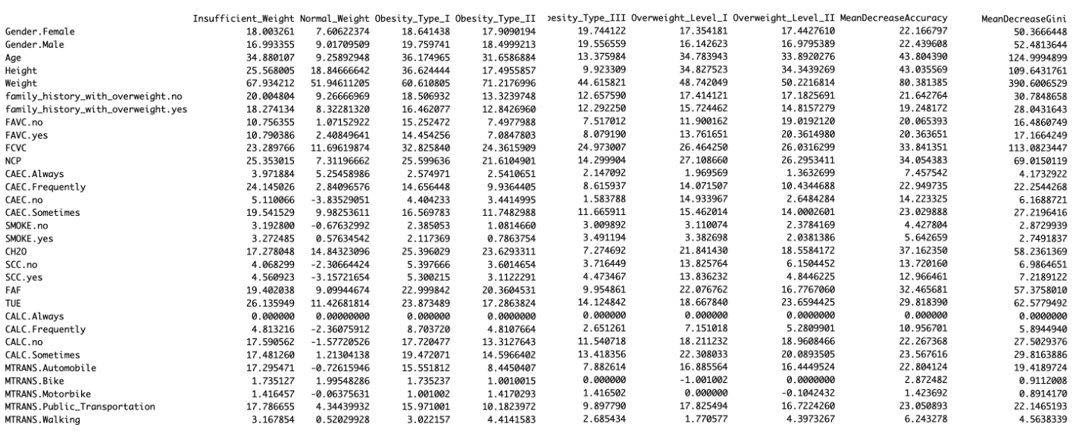
Variable Importance Table
Group 6

Slide 19
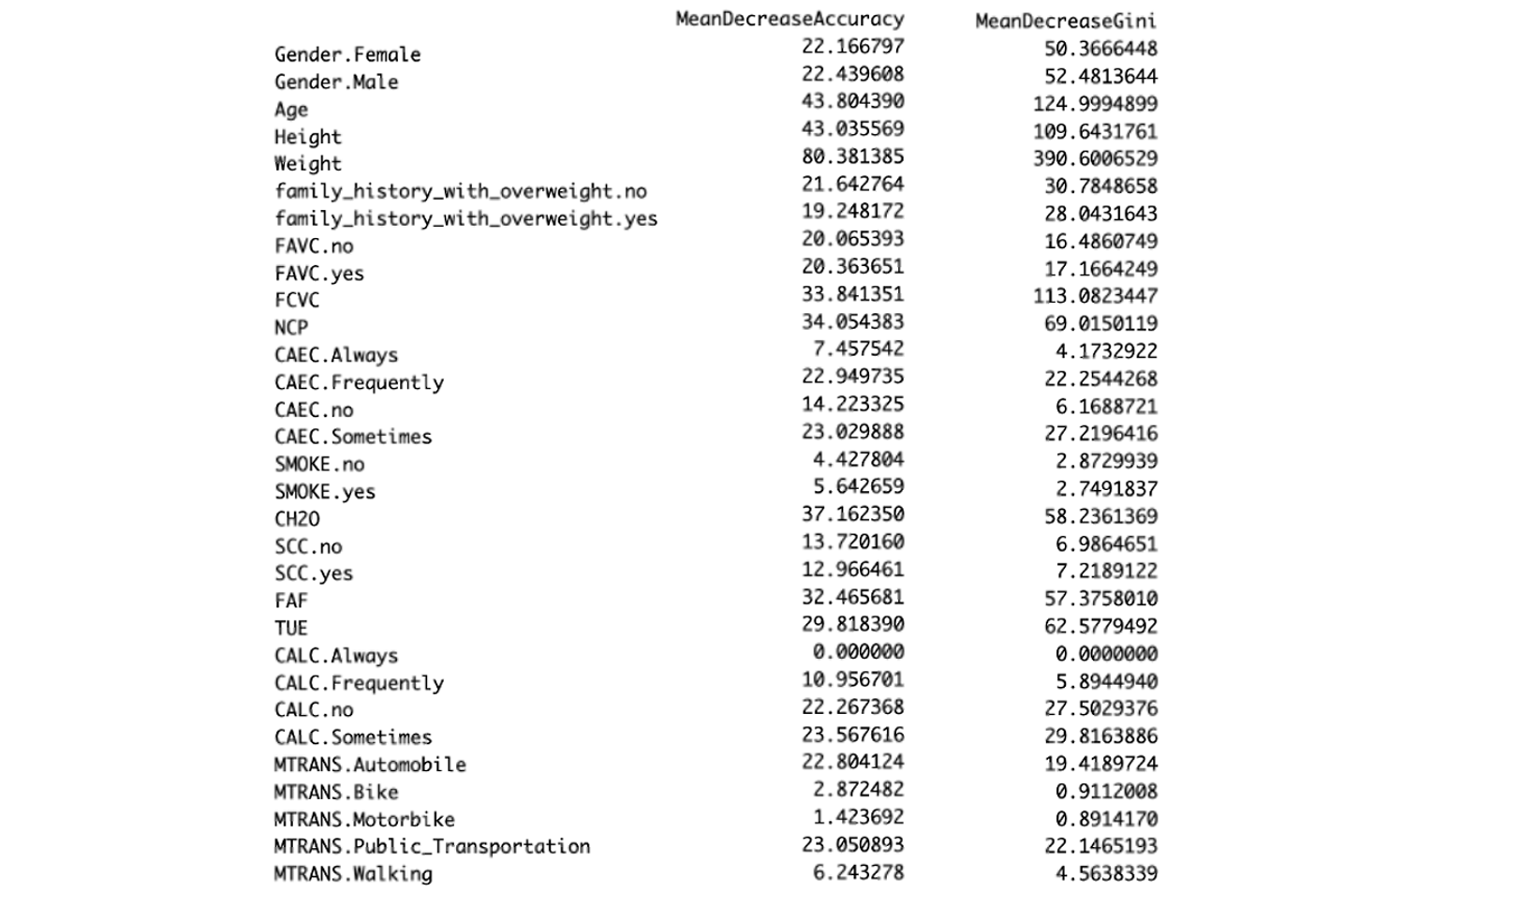

Group 6
Conclusion & Limitations
The analysis suggests that physical measurements, i.e., weight, and eating habits, i.e., vegetable consumption, are critical in predicting obesity levels.
Lower importance: SMOKEno, SMOKEyes, SCCno, SCCyes, MTRANS modes (different types of transportation)
The Classification Models have generally shown good performance.
Highest in Random Forest and Lowest in Naïve Bayes.
Limitations:
Ethnical aspect
The dataset has been retrieved from Mexico, Peru, and Colombia. Eating habits and physical condition may differ based on the region.
Distribution of Obesity Level
No class imbalance
Might indicate a sampling bias due to difference with the real world distribution

Slide 20
Thank you
STAT3622 Final Project Presentation by Group 6
Soo-ah Kim (3035661061) & Dongjun Yeom (3035666463)

